Slide 1
Internet of Things Workshop
Build your own device!

Slide 2
Agenda
Goal
Device
Sensor
Electrical Engineering Basics
Software

Slide 3
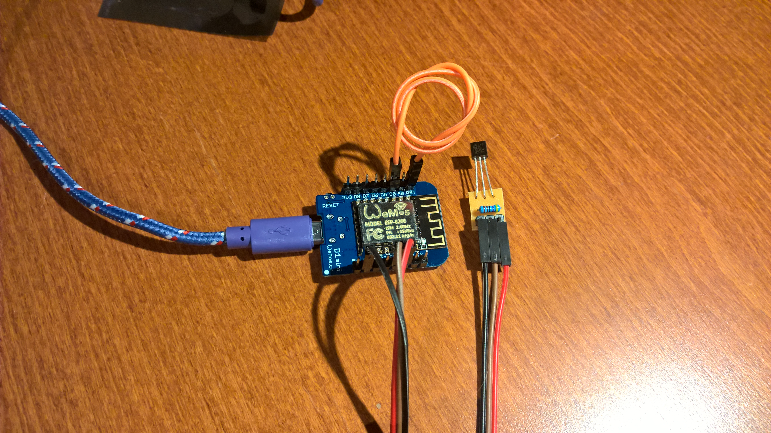
Goal

Slide 4
Real goal
Create an IoT device
Program an IoT device
Send data to the cloud secure
Process data
Store data
Analyze data
Display information

Slide 5
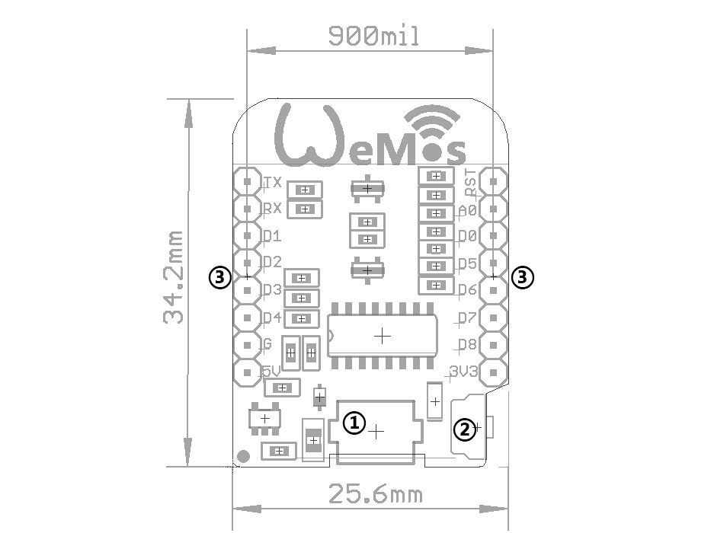
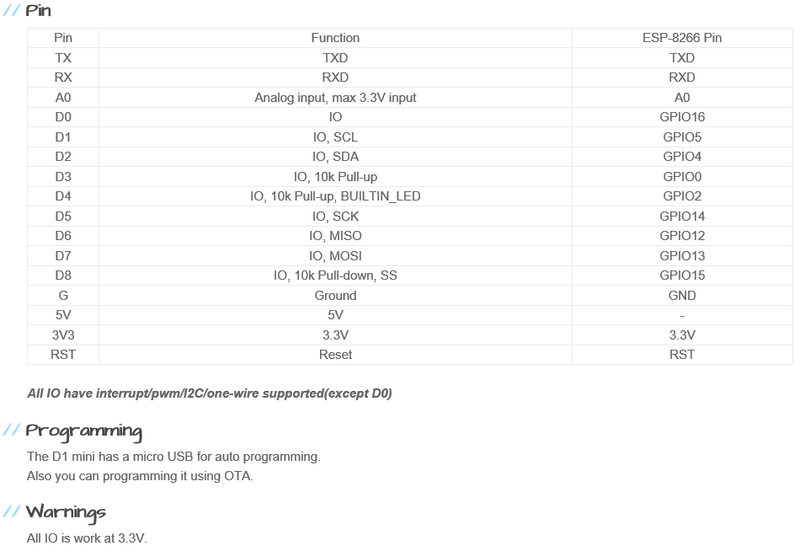
Device - WeMos D1 Mini
http://www.wemos.cc/Products/d1_mini.html

Slide 6
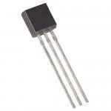
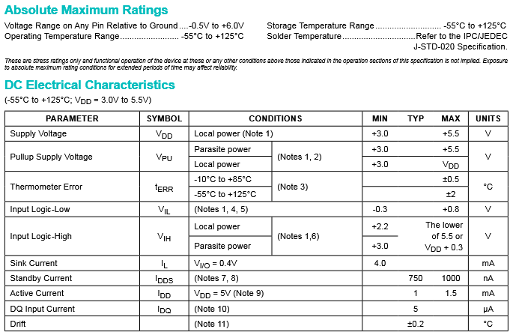
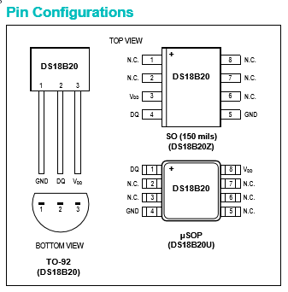
Sensor - Maxim DS18B20

Slide 7
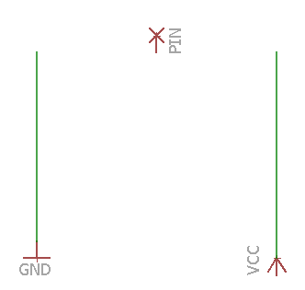
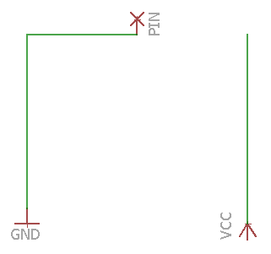
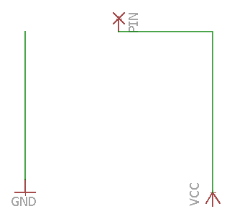
NC, GND, VCC

Slide 8
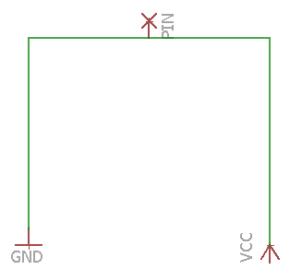
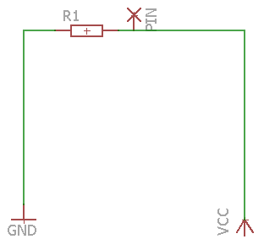
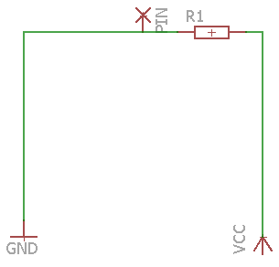
???

Slide 9
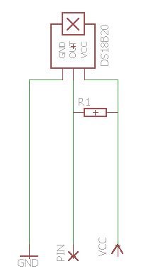
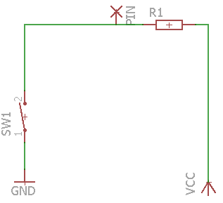
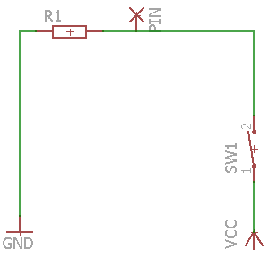
Pull up, Pull down, DS18B20 wiring

Slide 10
Device - WeMos D1 Mini
http://www.wemos.cc/Products/d1_mini.html

Slide 11

Ohm's law
V=I*R
I = V/R
R = V/I
V = Voltage
I = Current (Ampere)
R = Resistance (Ohm)
Power = V*I (Watt) => 16A * 220V = 3520Watt

Slide 12
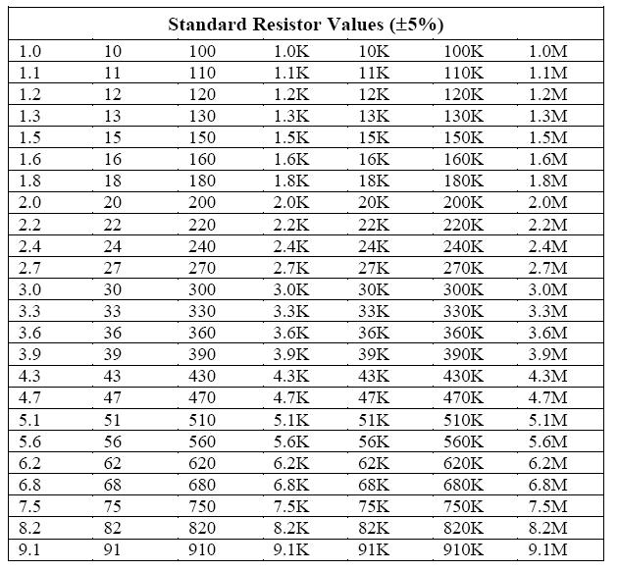
LED Resistor
Max Current = 20mA
Voltage Drop = 1.9V
Which resister is required if my development board supplies 3.3V?
3.3V – 1.9V = 1.4V
R = V/I = 1.4/0.020 = 70 => 75 Ohm resistor

Slide 13
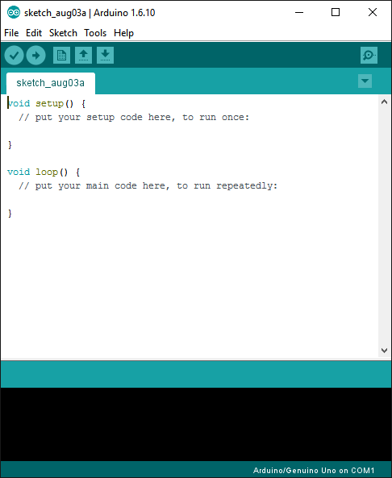
Arduino
https://www.arduino.cc/
The go to tool to create small solution for devices/boards
Board manager
Library manager

Slide 14

Visual Studio
https://www.visualstudio.com/
The tool for large/complex projects
If you want to develop for devices install with C++

Slide 15
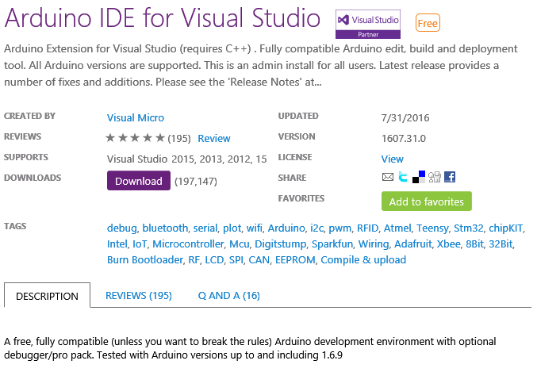
Visual Micro
The glue between Arduino and Visual Studio
Allows for debugging!

Slide 16
Labs
Lab 1
Wiring your device
Configure your device
Lab 2
Configure your evironment
Upload the latest code

